Slide 1
Lecture-10 Model Based Learning

Slide 2
Outline
Model-based RL
Dyna
Dyna Plus

Slide 3
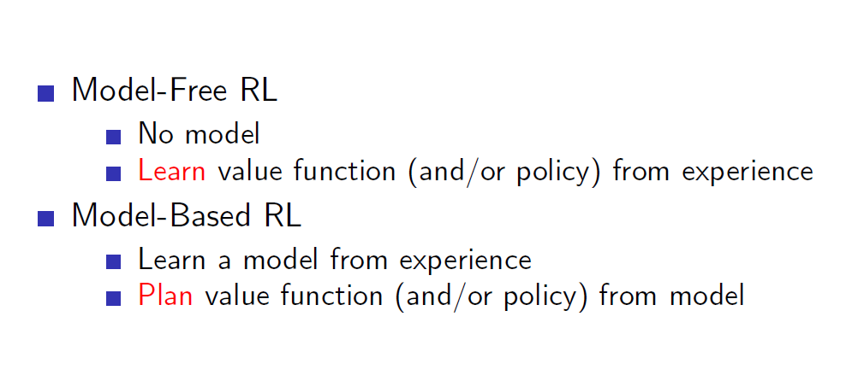
Model-Free & Model-Based

Slide 4
Model-free RL
No explicit transition or reward models
Q-learning: value-based method
Policy gradient: policy-based method
Actor critic: policy and value based method
Agent: update policy/value function
state reward
action
Environment

Slide 5
Model-based RL
Learn explicit transition and/or reward model
Plan based on the model
Benefit: Increased sample efficiency
Drawback: Increased complexity
plan
Agent: update model
Agent: update policy/value function
state reward
action
Environment

Slide 6
Model-based RL
Idea: at each step
Execute action
Observe resulting state and reward
Update transition and/or reward model
Update policy and/or value function

Slide 7
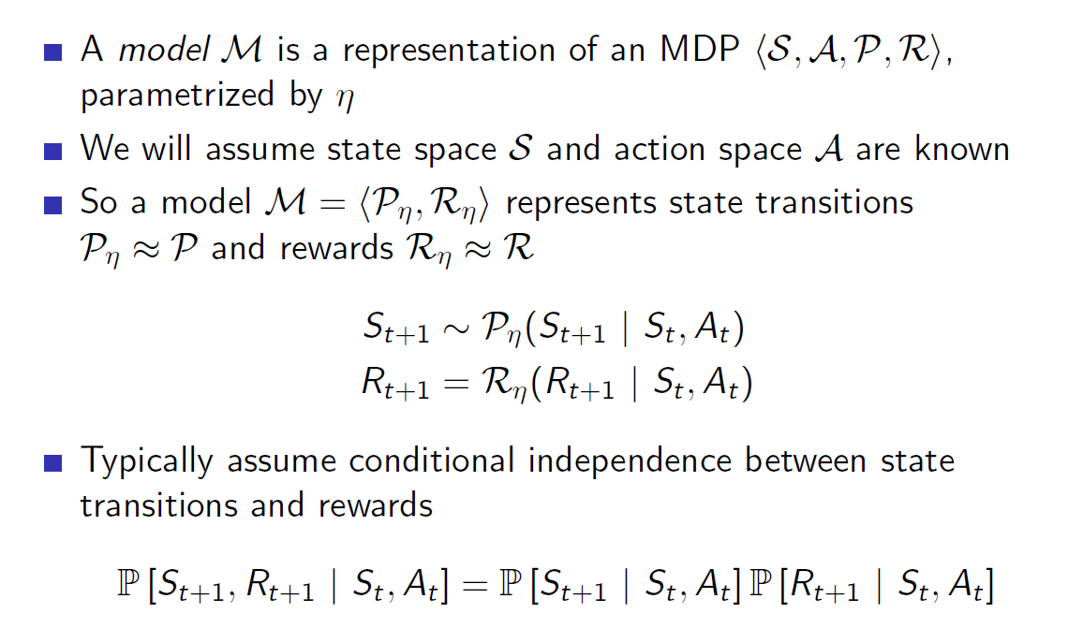
What is Model?

Slide 8
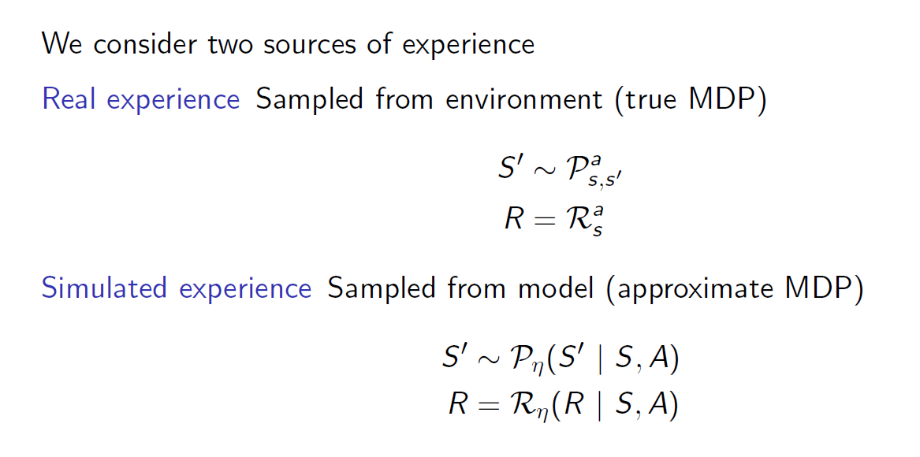
Real and Simulated Experience

Slide 9
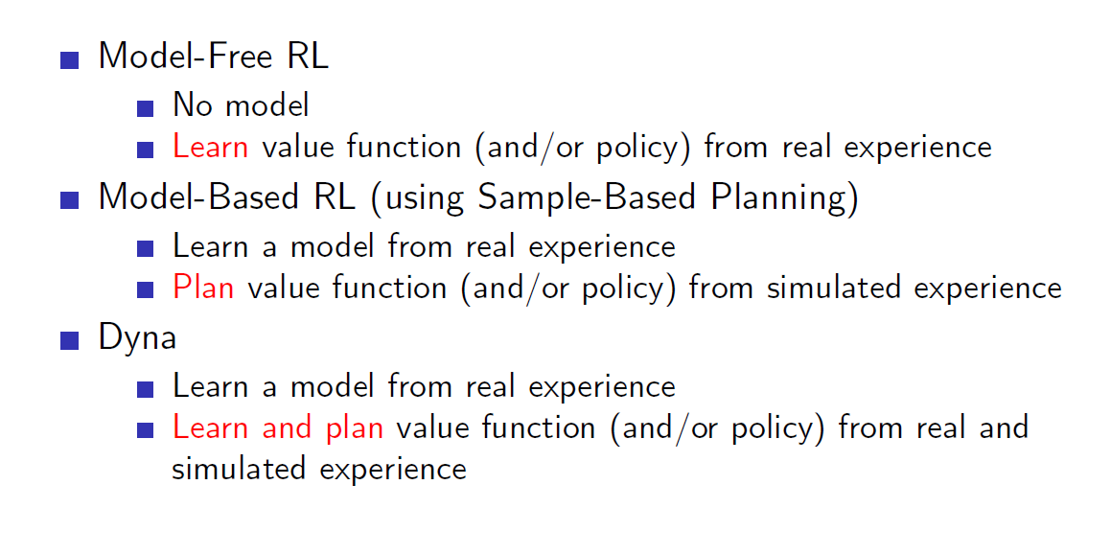
Comparison…

Slide 10
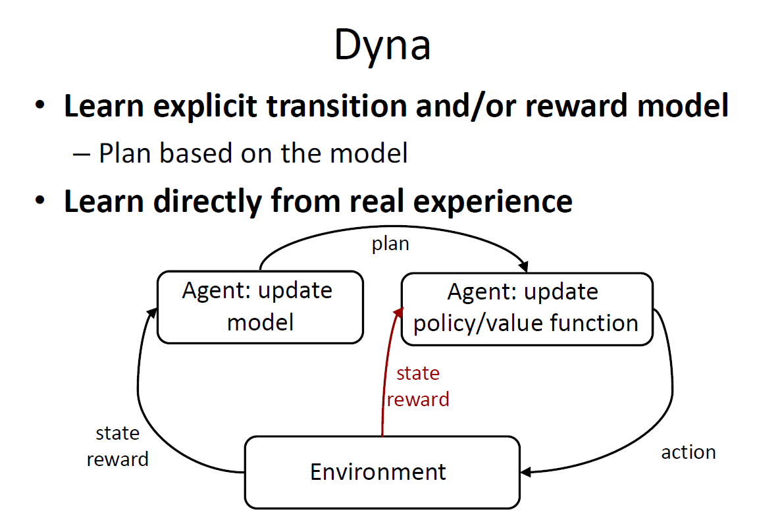

Slide 11
Why we choose Dyna?
One problem with Q-learning is that it takes many experience tuples to converge. Gathering experience from the real world is expensive because it requires us to take real action - executing a live trade in our case - to gather information.
To address this problem, researchers developed a technique called Dyna. Dyna works by building models of the transition function, T, and reward function, R. Then, after each real interaction with the world, we hallucinate many additional interactions, typically a few hundred, which we use to update the Q-table.

Slide 12
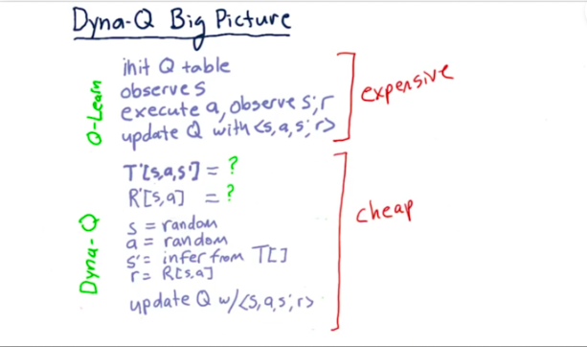
Dyna-Q Big Picture

Slide 13
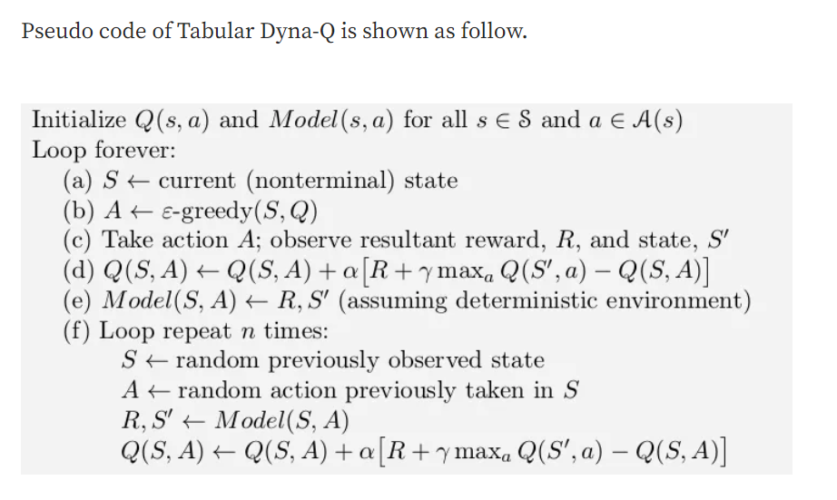
In the pseudocode algorithm for Dyna-Q in the box below, Model(s, a) denotes the contents of the (predicted next state and reward) for state–action pair (s, a). Direct reinforcement learning, model-learning, and planning are implemented by steps (d), (e), and (f), respectively. If (e) and (f) were omitted, the remaining algorithm would be one-step tabular Q-learning.

Slide 14
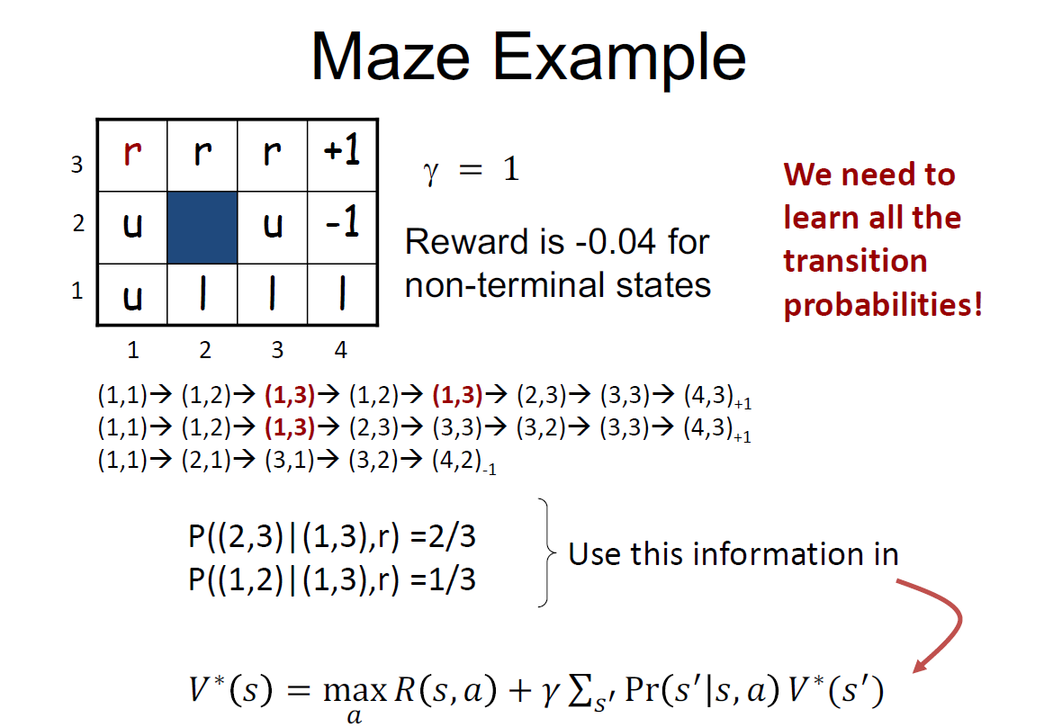

Slide 15
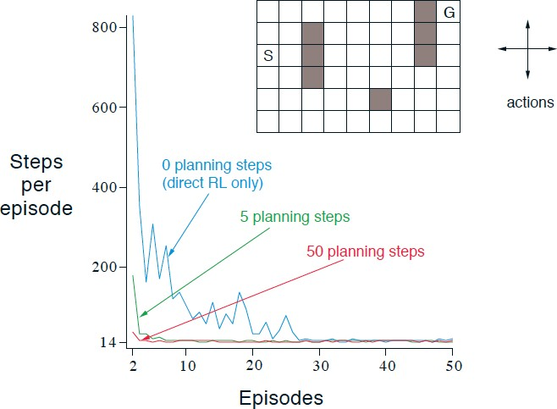
When the number of steps is set to 0, the Dyna-Q method is essentially Q-learning. Let’s compare the learning process with steps of 0, 5 and 50.

Slide 16
Two Problems with DYNA-Q
What if the model is wrong?
How to update the Q function more efficiently?
Models may be incorrect because the environment is stochastic and only a limited number of samples have been observed, or because the model was learned using function approximation that has generalised imperfectly, or simply because the environment has changed and its new behaviour has not yet been observed. When the model is incorrect, the planning process is likely to compute a suboptimal policy.

Slide 17
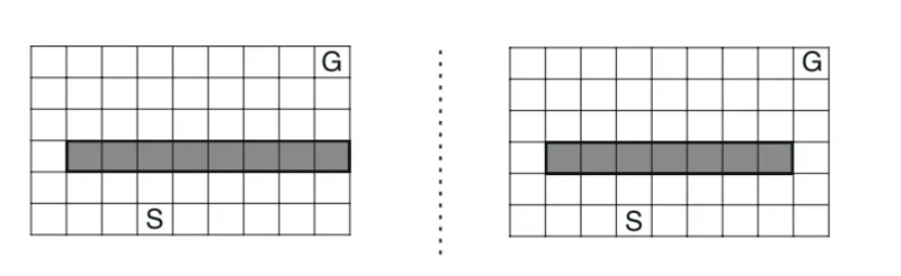
Shortcut Maze

Slide 18
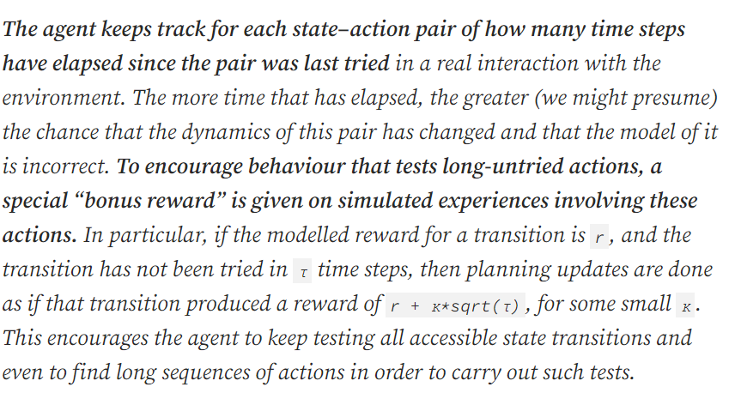
Solution: DYNA-Q+

Slide 19
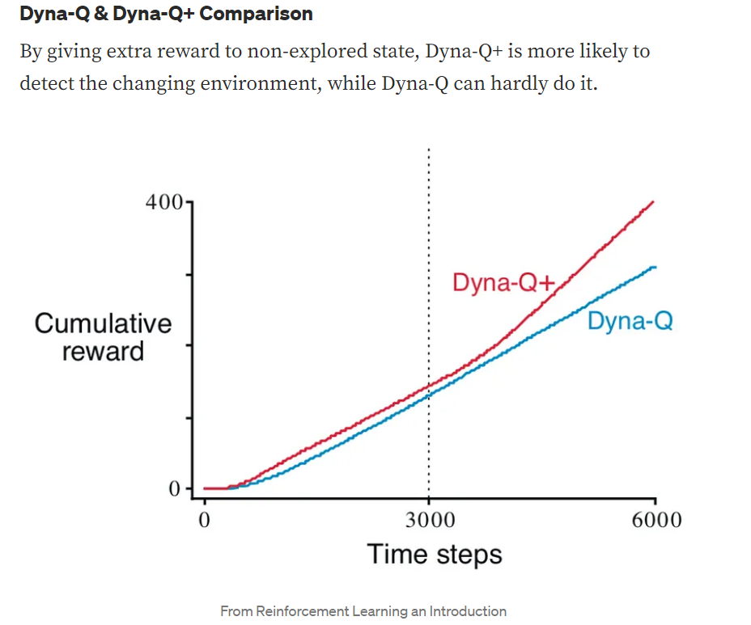

Slide 20
Summary:
To summarise, the algorithm is totally the same as Dyna-Q except that it keeps track of number of time a state has been visited, and give reward to state that has long not been visited(as these state could have possibly changed as time goes on).

Slide 21
MCTS Algorithm:
Monte Carlo Tree Search is a method usually used in games to predict the path (moves) that should be taken by the policy to reach the final winning solution.
Before we discover the right path(moves) that will lead us for the win. We first need to arrange the moves of the present state of the game. These moves connected together will look like a tree. Hence the name Tree Search.
Faster Tree Search can be achieved by making a policy — giving more importance to some nodes from others & allowing their children nodes to be searched first to reach the correct solution.
But how to find that node which is most favorable to have the correct solution in their children nodes

Slide 22
Definition:
MCTS is an algorithm that figures out the best move out of a set of moves by Selecting → Expanding → Simulating → Updating the nodes in tree to find the final solution. This method is repeated until it reaches the solution and learns the policy of the game.

Slide 23
Steps:
Nodes are the building blocks of the search tree. These nodes are formed based on the outcome of a number of simulations.
The process of Monte Carlo Tree Search can be broken down into four distinct steps, viz.,
1. Selection,
2. Expansion,
3. Simulation(Rollout)
4. Backpropagation.

Slide 24
Selection: In this process, the MCTS algorithm traverses the current tree from the root node using a specific strategy.
The strategy uses an evaluation function to optimally select nodes with the highest estimated value.
MCTS uses the Upper Confidence Bound (UCB) formula applied to trees as the strategy in the selection process to traverse the tree.
It balances the exploration-exploitation trade-off. During tree traversal, a node is selected based on some parameters that return the maximum value. The parameters are characterized by the formula that is typically used for this purpose is given below.

Slide 25
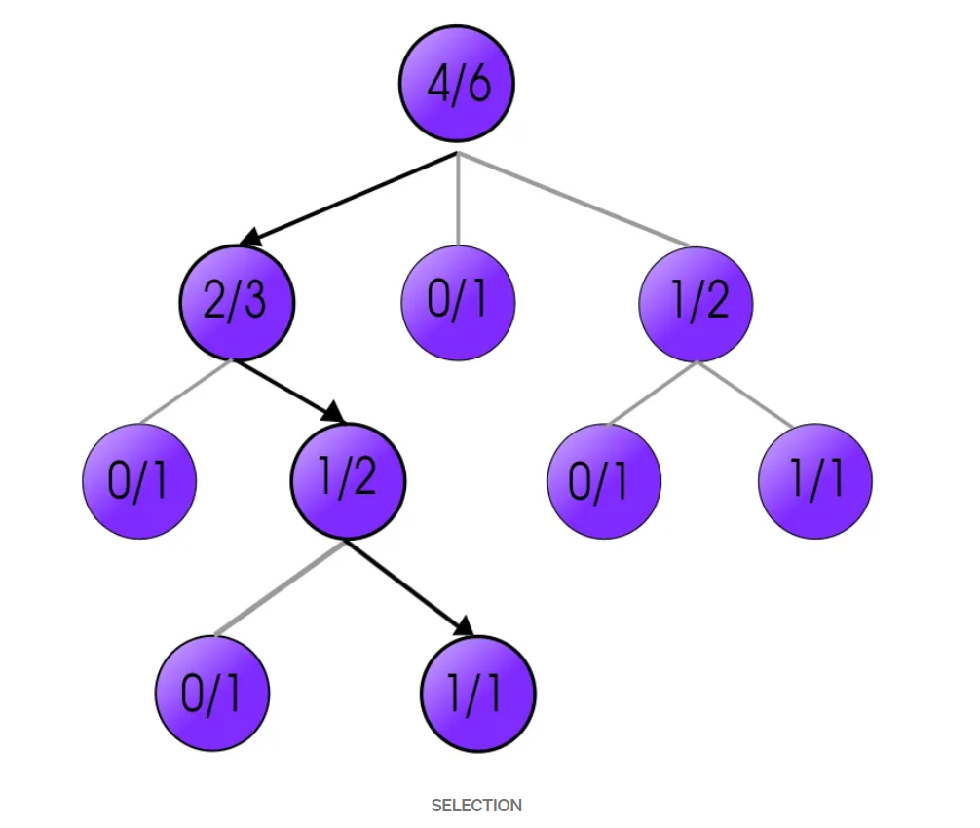
Example:

Slide 26
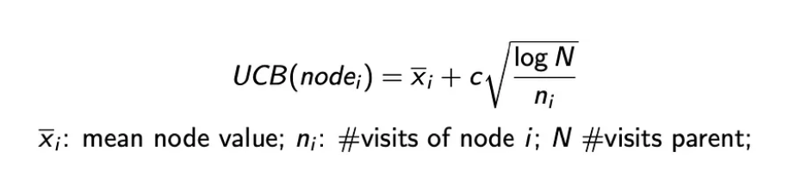
where; UCB_{i} = value of a node i x_{i} = empirical mean of a node i C = a constant N = total number of simulations When traversing a tree during the selection process, the child node that returns the greatest value from the above equation will be one that will get selected. During traversal, once a child node is found which is also a leaf node, the MCTS jumps into the expansion step.

Slide 27
Expansion: In this process, a new child node is added to the tree to that node which was optimally reached during the selection process.
Simulation(Roll-out): In this process, a simulation is performed by choosing moves or strategies until a result or predefined state is achieved.
During this step, we roll out one or multiple simulations with reward accumulated for each simulation. Roll-out policy is normally simply or even pure random such that it is fast to execute. For example, a win might induce reward of +1, a draw for 0, and a loss for -1.

Slide 28
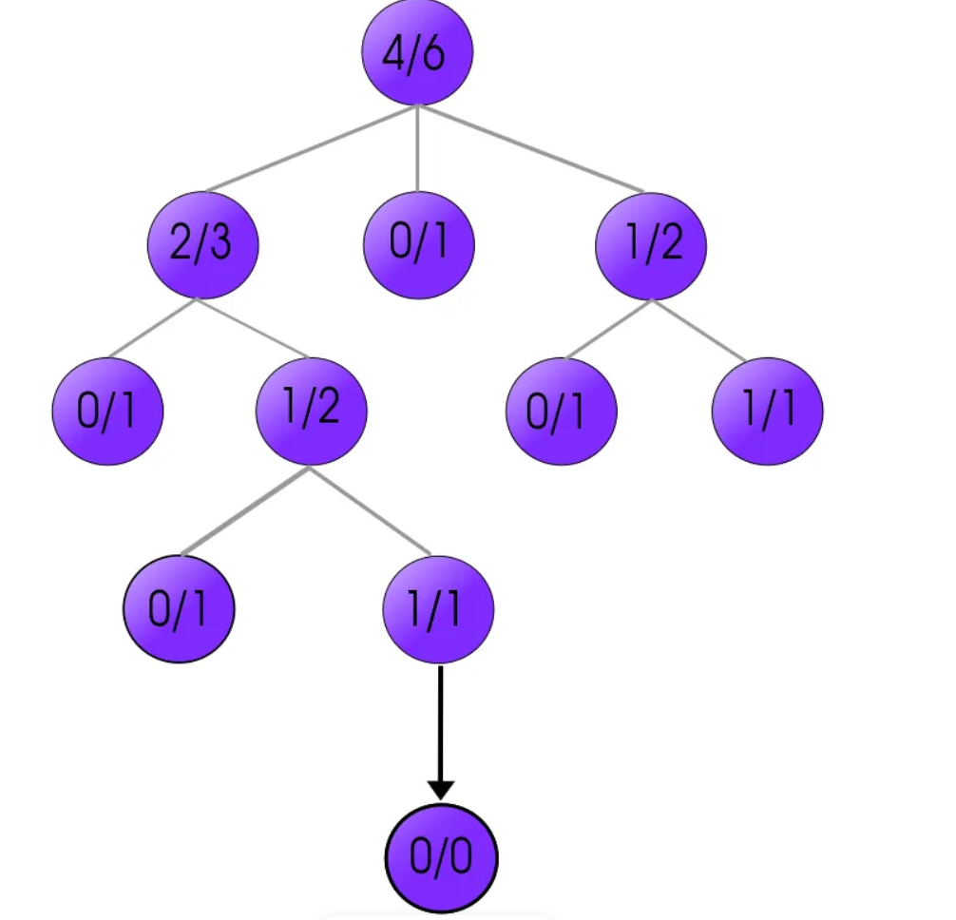
Example of Expansion:

Slide 29
Backpropagation: After determining the value of the newly added node, the remaining tree must be updated. So, the backpropagation process is performed, where it backpropagates from the new node to the root node. During the process, the number of simulation stored in each node is incremented. Also, if the new node’s simulation results in a win, then the number of wins is also incremented.

Slide 30
Conclusion:
Monte Carlo Tree Search algorithm chooses the best possible move from the current state of Game’s Tree with the help of Reinforcement Learning.

